Slide 1
Computer Organization and Architecture
Module 6 (Part 1)
Design of Memory Subsystems
Department of Computer Science and Engineering
IIT Kharagpur

Slide 2
PROCESSOR MEMORY INTERACTION

Slide 3
Introduction
Memory is one of the most important functional units of a computer.
  Used to store both instructions and data.
  Stores as bits (0’s and 1’s), usually organized in terms of bytes.
How are the data stored in memory accessed?
  Every memory location has a unique address.
  A memory is said to be byte addressable if every byte of data has a unique address.
  Some memory systems are word addressable also (every addressed location consists of multiple bytes, say, 32 bits or 4 bytes).

Slide 4
Connection between Processor and Memory
Address bus provides the address of the memory location to be accessed.
Data bus transfers the data read from memory, or data to be written into memory.
  Bidirectional.
Control bus provides various signals like READ, WRITE, etc.
PROCESSOR
MA R
Address
PRIMARY
MEMORY
MD R
Data
Control

Slide 5
An Example Memory Module
n address lines :: The maximum number of memory locations that can be accessed is 2^{n}.
m data lines :: The number of bits stored in every addressable location is m.
The RD/WR’ control line selects the memory for reading or writing (1: read, 0: write).
The chip select line (CS’) when active (=0) will enable the chip; otherwise, the data bus is in the high impedance state.
n-bit address bus
m-bit data bus
MEMORY
(2^{n} addressable memory locations)
RD/WR’
CS’
The memory size is specified as 2^{n} x m

Slide 6
Classification of Memory Systems
Volatile versus Non-volatile:
  A volatile memory system is one where the stored data is lost when the power is switched off.
    Examples: CMOS static memory, CMOS dynamic memory.
    Dynamic memory in addition requires periodic refreshing.
  A non-volatile memory system is one where the stored data is retained even when the power is switched off.
    Examples: Read-only memory, Magnetic disk, CDROM/DVD, Flash memory, Resistive memory.

Slide 7
Random-access versus Direct/Sequential access:
  A memory is said to be random-access when the read/write time is independent of the memory location being accessed.
    Examples: CMOS memory (RAM and ROM).
  A memory is said to be sequential access when the stored data can only be accessed sequentially in a particular order.
    Examples: Magnetic tape, Punched paper tape.
  A memory is said to be direct or semi-random access when part of the access is sequential and part is random.
    Example: Magnetic disk.
    We can directly go to a track after which access will be sequential.

Slide 8
Do not edit
How to change the design
Which type of memory loses data when power is switched off?
The Slido app must be installed on every computer you’re presenting from

Slide 9
Read-only versus Random-access:
  Read-only Memory (ROM) is one where data once stored in permanent or semi-permanent.
    Data written (programmed) during manufacture or in the laboratory.
    Examples: ROM, PROM, EPROM, EEPROM.
  Random Access Memory (RAM) is one where data access time is the same independent of the location (address).
    Can be read as well as written.
    Used in main / cache memory systems.
    Example: Static RAM (SRAM) → data once written are retained as long as power is on.
    Example: Dynamic RAM (DRAM) → requires periodic refreshing even when power is on (data stored as charge on tiny capacitors).

Slide 10
Access Time, Latency and Bandwidth
Terminologies used to measure speed of the memory system.
  Memory Access Time: Time between initiation of an operation (Read or Write) and completion of that operation.
  Latency: Initial delay from the initiation of an operation to the time the first data is available.
  Bandwidth: Maximum speed of data transfer in bytes per second.
In modern memory organizations, every read request reads a block of words into some high-speed registers (LATENCY), from where data are supplied to the processor one by one (ACCESS TIME).

Slide 11
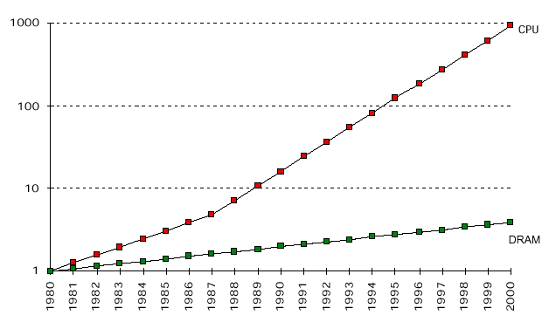
Design Issue of Memory System
The most important issue is to bridge the processor-memory gap that has been widening with every passing year.
  Advancements in memory technology are unable to cope with faster advancements in processor technology.

Slide 12
Some important questions?
  How to make the memory system work faster?
  How to increase the data transfer rate between CPU and memory?
  How to address the ever increasing storage needs of applications?
Some possible solutions:
  Cache Memory: to increase the effective speed of the memory system.
  Virtual Memory: to increase the effective size of the memory system.

Slide 13
What is Cache Memory?
It is a fast memory (possibly organized in several levels) that sits between processor and main memory.
  Faster than main memory and relatively small in capacity.
  Frequently accessed data and instructions are stored here.
  Cache memory makes use of the fast SRAM technology.
  Typically there are multiple levels of cache memory (L-1, L-2, L-3).
Main Memory
Level-2 Cache
CPU
Level-1 Cache

Slide 14
What is Virtual Memory?
Technique used by the operating system to provide an illusion of very large memory to the processor.
  Program and data are actually stored on secondary memory that is much larger.
  Transfer parts of program and data from secondary memory to main memory only when needed.
Secondary Memory
Main Memory
CPU

Slide 15
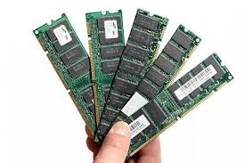
How does a Memory Chip look like?
Memory cells are organized in the form of an array.
Every memory cell holds one bit of data.
Present-day VLSI technology allows one to pack billions of bits per chip.
A memory module used in computers typically contains several such chips.

Slide 16
Organization of Cells in an 8 x 4 Memory Chip
W₀
b₃
b’₃
b₂
b’₂
b₁
b’₁
b₀
b’₀
Address Decoder
3 X 8
W₁
W₂
W₃
Memory Cells
A₀
W₄
A₁
A₂
W₅
W₆
W₇
R/W’
Sense/Write circuit
Sense/Write circuit
Sense/Write circuit
Sense/Write circuit
CS’

Slide 17
A 32-bit memory chip organized as 8 x 4 is shown.
Every row of the cell array constitutes a memory word.
A 3 x 8 decoder is required to access any one of the 8 rows.
The rows of the cells are connected to the word lines.
Individual cells are connected to two bit lines.
  Bit b and its complement b’.
  Required for reading and writing.
Cells in each column are connected to a sense/write circuit by the two bit lines.
Other than address and data lines, there are two control lines: R/W’ and CS’ (Chip Select).
  CS is required to select one single chip in a multi-chip memory system.

Slide 18
External Connection Requirements
The 8 x 4 memory requires the following external connections:
  Address decoder of size: 3 x 8
    3 external connections for address.
  Data output : 4-bit
    4 external connections for data.
  2 external connections for R/W’ and CS’.
  2 external connections for power supply and ground.
  Total of 3 + 4 + 2 + 2 = 11.

Slide 19
What About a 256 x 16 Memory?
Here the total number of external connections are estimated as follows:
  Address decoder size: 8 x 256
    8 external connections for address.
  Data output : 16-bit
    16 external connections for data.
  2 external connections for R/W’ and CS’.
  2 external connections for power supply and ground.
  Total of 8 + 16 + 2 + 2 = 28.

Slide 20
STATIC AND DYNAMIC RAM

Slide 21
Introduction
Broadly two types of semiconductor memory systems:
  Static Random Access Memory (SRAM)
  Dynamic Random Access Memory (DRAM)
    Asynchronous DRAM
    Synchronous DRAM
Vary in terms of speed, density, volatility properties, and cost.
  Present-day main memory systems are built using DRAM.
  Cache memory systems are built using SRAM.

Slide 22
Static Random Access Memory (SRAM)
SRAM consists of circuits which can store the data as long as power is applied.
It is a type of semiconductor memory that uses bistable latching circuitry (flip-flop) to store each bit.
SRAM memory arrays can be arranged in rows and columns of memory cells.
  Called word line and bit line.

Slide 23
SRAM technology:
  Can be built using 4 or 6 MOS transistors.
  Modern SRAM chips in the market uses 6-transistor implementations for CMOS compatibility.
  Widely used in small-scale systems like microcontrollers and embedded systems.
  Also used to implement cache memories in computer systems.
    To be discussed later.

Slide 24
A 1-bit SRAM Cell
Two inverters are cross connected to form a latch.
The latch is connected to two bit lines with transistors T1 and T2.
Transistors behave like switches that can be opened (OFF) or closed (ON) under the control of the word line.
To retain the state of the latch, the word line can be grounded which makes the transistors off.
Bit lines
T₁
T₂
A
B
Word line
b
b’

Slide 25
(a) READ Operation in SRAM
Bit lines
To read the content of the cell, the word line is activated (= 1) to make the transistors T1 and T2 on.
The value stored in latch is available on bit line b and its complement on b’.
Sense/write circuits connected to the bit lines monitor the states of b and b’.
T₁
T₂
A
B
Word line
b
b’

Slide 26
(b) WRITE Operation in SRAM
Bit lines
To write 1: The bit line b is set with 1 and bit line b’ is set with 0. Then the word line is activated and the data is written to the latch.
To write 0: The bit line b is set with 0 and bit line b’ is set with 1. Then the word line is activated and the data is written to the latch.
The required signals (either 1 or 0) are generated by the sense/write circuit.
T₁
T₂
A
B
Word line
b
b’

Slide 27
6-Transistor Static Memory cell
Bit lines
1-bit SRAM cell with 6-transistors are used in modern-day SRAM implementations.
Transistors (T3 &T5) and (T4 &T6) form the CMOS inverters in the latch.
The data can be read or written in the same way as explained.
T₃
T₄
T₁
T₂
X
Y
T₅
T₆
b
Word line
b’

Slide 28
In State 0
Bit lines
In state 0 the voltage at X is low and the voltage at Y is high.
When the voltage at X is low, transistors (T4 & T5) are on while (T3 & T6) are off.
When word line is activated, T1 and T2 are turned on and the bit lines b will have 0 and b’ will have 1.
T₃
T₄
T₁
T₂
X
Y
T₅
T₆
b
Word line
b’

Slide 29
In State 1
Bit lines
In state 1 the voltage at X is high and the voltage at Y is low.
When the voltage at X is high, transistors (T3 & T6) are on while (T4 & T5) are off.
When word line is activated, T1 and T2 are turned on and the bit lines b will have 1 and b’ will have 0.
T₃
T₄
T₁
T₂
X
Y
T₅
T₆
b
Word line
b’

Slide 30
Features of SRAM
Moderate / High power consumption.
  Current flows in the cells only when the cell is accessed.
  Because of latch operation, power consumption is higher than DRAM.
Simplicity – refresh circuitry is not needed.
  Volatile :: continuous power supply is required.
Fast operation.
  Access time is very fast; fast memories (cache) are built using SRAM.
High cost.
  6 transistors per cell.
Limited capacity.
  Not economical to manufacture high-capacity SRAM chips.

Slide 31
Do not edit
How to change the design
Which feature best matches SRAM?
The Slido app must be installed on every computer you’re presenting from

Slide 32
Dynamic Random Access Memory (DRAM)
Dynamic RAM does not retain its state even if power supply is on.
  Data stored in the form of charge stored on a capacitor.
Requires periodic refresh.
  The charge stored cannot be retained over long time (due to leakage).
Less expensive that SRAM.
  Requires less hardware (one transistor and one capacitor per cell).
Address lines are multiplexed.
Bit line
Word line
T
C
Sense/Write Circuit
1-transistor DRAM Cell

Slide 33
(a) READ Operation in DRAM
Bit line
The transistor of the particular cell is turned on by activating the word line.
A sense amplifier connected to bit line senses the charge stored in the capacitor.
If the charge is above threshold, the bit line is maintained at high voltage, which represents logic 1.
If the charge is below threshold, the bit line is grounded, which represent logic 0.
Word line
T
C
Sense/Write Circuit

Slide 34
(b) WRITE Operation in DRAM
Bit line
The transistor of the particular cell is turned on by activating the word line.
Depending on the value to be written (0 or 1), an appropriate voltage is applied to the bit line.
The capacitor gets charged to the required voltage state.
Refreshing of the capacitor requires periodic READ-WRITE cycles (every few msec).
Word line
T
C
Sense/Write Circuit

Slide 35
Types of DRAM
Asynchronous DRAM (ADRAM)
  Timing of the memory device is handled asynchronously.
  A special memory controller circuit generates the signals asynchronously.
  DRAM chips produced between the early 1970s to mid-1990s used asynchronous DRAM.
Synchronous DRAM (SDRAM)
  Memory operations are synchronized by a clock.
  Concept of SDRAM came in the 1970s.
  Commercially made available only in 1993 by Samsung.
  By 2000 SDRAM replaced almost all types of DRAMs in the market.
  Performance of SDRAM is much higher compared to all other existing DRAM.

Slide 36
Asynchronous DRAM

Slide 37
Asynchronous DRAM
The timing of the memory device is controlled asynchronously.
The device connected to this memory is responsible for the delay.
Address lines are divided into two parts and multiplexed.
  Upper half of address:
    Loaded into Row Address Latch using Row Address Strobe (RAS).
  Lower half of address:
    Loaded into Column Address Latch using Column Address Strobe (CAS).

Slide 38
Internal Organization of a DRAM Chip
Cells are organized in the form of an array, in rows and columns.
Cells of each row are divided into fixed number of columns, m bits each.
m is 8, 16, 32 or 64.
RAS’
Memory
Cell Array
x
x
Row
Address
Latch
Row
Decoder
.
.
.
...
CS’
A_{n-1} – A₀
Sense/Write
...
R / W’
y
y
Column
Address
Latch
Column
Decoder
CAS’
D_{m-1} – D₀

Slide 39
Suppose that the memory cell array is organized as r x c.
  r rows and c columns.
An x-bit address is required to select a row r, where x = log₂r.
An y-bit address is required to select a column c, where y = log₂c.
Total address bits: n = x (high order) + y (low order)

Slide 40
READ or WRITE Operation
For a read operation, the x-bit row address is applied first.
  It is loaded into Row Address Latch in response to the signal RAS’.
  The read operation is performed in which all the cells of the selected row are read and refreshed.
  After loading of row address, the column address is selected.
  In response to CAS’ the column address is loaded into Column Address Latch.
  Then the column decoder selects a particular column from c columns and an appropriate group of m sense/write circuits are selected.

Slide 41
For a READ operation, the output values of the selected circuits are transferred to data lines D_{m-1} to D_{0.}
For a WRITE operation, the data available on the data lines D_{m-1} to D₀ is transferred to the selected circuits.
  This information is stored in the selected cell.
Both RAS’ and CAS’ are active low signals. That is they cause latching the addresses when they move from high to low.
Each row of the cell array must be periodically refreshed to prevent data loss.
Cost is low but access time is high compared to SRAM.
Very high packing density (few billion cells per chip).
Widely used in the main memory of modern computer systems.

Slide 42
An Example: 1 Gbit ADRAM Chip
We assume that the 1 Gbit memory cells are organized as 32768 (2¹⁵) rows and 32768 (2¹⁵) columns.
Let us assume that data bus is 32-bit long.
So, the memory can be organized as (2¹⁵) x (2¹⁰ x 2⁵).
  Total number of address lines is 25 bits.
High order 15 bits of the address is used to select a row.
  Requires a 15 x 32768 row-address decoder.
Low order 10 bits of the address is used to select a column.
  Requires a 10 x 1024 column decoder.

Slide 43
32768 x (1024 x 32)
RAS’
15 x 32768
Memory
Cell Array
x = 15
x
Row
Address
Latch
Row
Decoder
.
.
.
A₂₄ – A₁₀
...
CS’
A₂₄ – A₀
Sense/Write
...
y = 10
R / W’
y
Column
Address
Latch
Column
Decoder
A₉ – A₀
CAS’
32 data lines
D₃₁ – D₀

Slide 44
Operation:
  15-bit row address is selected (i.e., x = 15).
  With the help of RAS control signal the row address is latched. The 15 x 32768 Row Decoder selects a particular row.
  Then the 10-bit column address is applied and with the help of CAS the address is latched. The 10 x 1024 column decoder selects a particular column.
  A group of 32 bits are selected as the 32-bit word to be accessed.

Slide 45
Fast Page Mode
RAS’
c
r
Row
Address
Latch
Row
Decoder
:
...
.
.
.
.
...
CS’
A_{n-1} – A₀
Sense/Write
...
R/W’
Column
Address
Latch
Column Decoder
Latch
D_{m-1} – D₀
CAS’

Slide 46
Operation:
  When the DRAM cell is accessed only an m-bit word (data bus width) is transferred.
  But when we select a row, we can select not only the data of a single column but multiple columns as well.
  A latch can be connected at the output of the sense amplifier in each column.
  Once we apply a row address, the row get selected.
      Different column addresses are required to place different bytes on the data lines.
  Hence consecutive bytes can be transferred by applying consecutive column addresses under the control of successive CAS signals.
  This also helps in faster transfer of blocks of data.
  This block transfer capability is termed as Fast Page Mode access.

Slide 47
Synchronous DRAM

Slide 48
Synchronous DRAM
SDRAM is the commonly used name for various kinds of dynamic RAM that are synchronized with clock.
The structure of this memory is same as asynchronous DRAM.
The concept of SDRAM were known from 70’s but it is first developed by Samsung in the year 1993 (KM48SL2000).
  By 2000 all kinds of DRAM were replaced by SDRAM.

Slide 49
Internal Organization of a SDRAM Chip
Refresh
Counter
Cell array
Row
address
latch
Row
Decoder
Row/Column address
...
Column
address
counter
Column
Decoder
Read/Write circuits and latches
...
clock
Mode register and Timing control
RAS’
Data input register
Data output register
CAS’
R / W’
CS’

Slide 50
In SDRAM address and data connections are buffered by registers.
The output of individual sense amplifier is connected to a latch.
Mode register is present which can be set to operate the memory chip in different modes.
To select successive columns it is not required to provide externally generated pulses on CAS line.
A column counter is used internally to generate the required signals.

Slide 51
READ and WRITE Operations
For READ operation, the row address is applied first, and in response to the column address, the data present in the latches for the selected columns are transferred to the data output register.
  Then the data is available on the data bus.
For WRITE operation, the row address is applied first, and in response to the column address, the data present in the data bus is made available to the latches through data input register.
  The data is then written to the particular cell.

Slide 52
Burst mode transfer
As in fast page mode, after the column address is applied the data from successive column addresses are read out or written into.
In same way burst operation of different lengths can be specified.
This uses the same block transfer capability of fast page mode.
Here the control signals required are provided internally by column counter and clock signals.
New set of data are available in the data lines after every clock cycle.
All the operations are triggered at the rising edge of the clock.
It has built-in refresh circuitry, and refresh counter is part of it.

Slide 53
Standardization
SDRAM families are standardized by Joint Electron Device Engineering Council (JEDEC).
  Various DDRx standards have been formulated and published by JEDEC.
  Board manufacturers comply by the standards.

Slide 54
Types of SDRAM
Single data rate SDRAM (called SDR) can accept one command and transfer one word of data per clock cycle.
  Data transferred typically on the rising edge of the clock.
Double data rate SDRAM (called DDR) transfers data on both the rising and falling edges of the clock.
DDR SDRAM was launched in 2000.
DDR2 (2003), DDR3 (2007), DDR4 (2014).

Slide 55
Do not edit
How to change the design
What is the key difference between SDR and DDR SDRAM?
The Slido app must be installed on every computer you’re presenting from

Slide 56
DDR2
The internal bus width also grows with newer generations of DDR SDRAM.
Internal clock: 133 MHz
Bus clock: 266 MHz
Transfer rate: 4.26 GB/s

Slide 57
DDR3
Internal clock: 133 MHz
Bus clock: 533 MHz
Transfer rate: 8.53 GB/s

Slide 58
DDR4
Internal clock: 133 MHz
Bus clock: 1067 MHz
Transfer rate: 17.06 GB/s

Slide 59
Name | Internal Clock | Bus Clock | Transfer Rate
DDR2-400 | 100 MHz | 200 MHz | 3.20 GB/s
DDR2-400 | 133 MHz | 266 MHz | 4.26 GB/s
DDR2-667 | 166 MHz | 333 MHz | 5.33 GB/s
DDR2-800 | 200 MHz | 400 MHz | 6.40 GB/s
DDR3-800 | 100 MHz | 400 MHz | 6.40 GB/s
DDR3-1066 | 133 MHz | 533 MHz | 8.53 GB/s
DDR3-1333 | 166 MHz | 667 MHz | 10.67 GB/s
DDR3-1600 | 200 MHz | 800 MHz | 12.80 GB/s
DDR4-1600 | 100 MHz | 800 MHz | 12.80 GB/s
DDR4-2133 | 133 MHz | 1066 MHz | 17.06 GB/s
DDR4-3200 | 200 MHz | 1600 MHz | 25.60 GB/s
Generations of DDRx SDRAM

Slide 60
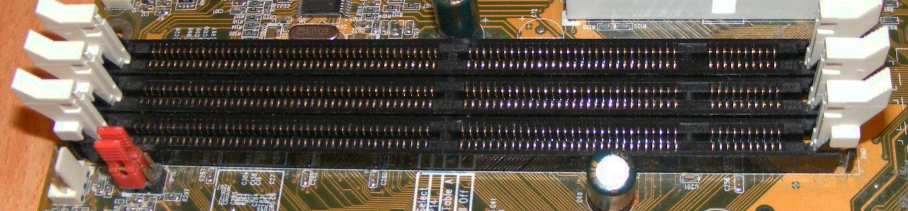
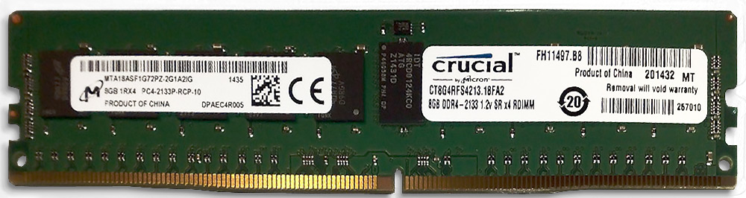
A dual in-line memory module (DIMM) consists of a number of DRAM ICs.
These modules are mounted on a printed-circuit board and designed for use in PCs, workstations and servers.
DIMMs have separate electrical contacts on each side of the module, and has a 64-bit data path.
Three SRDAM DIMM slots on a PC motherboard
Two 8 GB DDR4-2133 ECC 1.2V modules

Slide 61
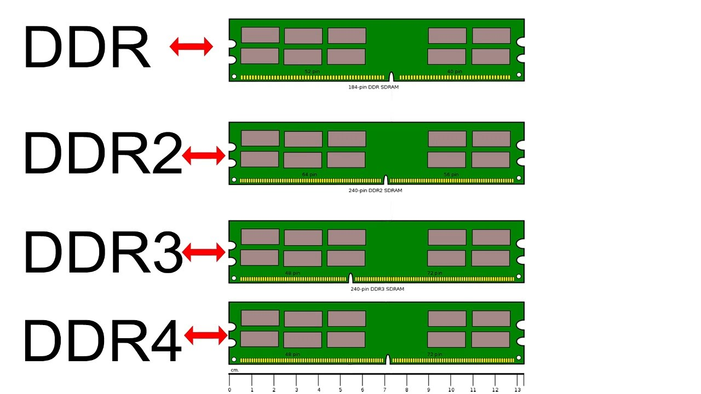
The DDR memory modules across generations may not be compatible.
They may have notches in different positions.

Slide 62
DDR Generations: To Summarize
SDR SDRAMs can transfer one word of data per clock cycle.
DDR (or DDR1) SDRAMs can transfer two words per clock cycle.
DDR2 SDRAM doubles the minimum read or write unit again, to 4 consecutive words per clock cycle.
DDR3 continues the trend, doubling the minimum read or write unit to 8 consecutive words per clock cycle.
DDR4 extends the trend again to 16 consecutive words per clock cycle.
In March 2017, a DDR5 standard under development has been announced.

Slide 63
Speed of DDR Memories Across Generations
Year | Chip size | Type | Slowest DRAM | Fastest DRAM | CAS transfer time | Cycle time
2000 | 256 Mb | DDR1 | 65 ns | 45 ns | 7 ns | 90 ns
2002 | 512 Mb | DDR1 | 60 ns | 40 ns | 5 ns | 80 ns
2004 | 1 Gb | DDR2 | 55 ns | 35 ns | 5 ns | 70 ns
2006 | 2 Gb | DDR2 | 50 ns | 30 ns | 2.5 ns | 60 ns
2010 | 4 Gb | DDR3 | 36 ns | 28 ns | 1 ns | 37 ns
2012 | 8 Gb | DDR3 | 30 ns | 24 ns | 0.5 ns | 31 ns

